Slide 1
International Small Arms Control Standards (ISACS)
Photo: MAG
Photo: MAG
Practical guidance on implementing global commitments
to control small arms and light weapons

Slide 2
Objectives
At the end of this presentation, you should…
know what the ISACS project is all about (why, what, who where, how, etc.)
have an overview of all ISACS modules
have a closer understanding of the operational ISACS modules
know where to find the ISACS modules & Assessment Tool
be thinking about how ISACS could help you in your work

Slide 3
What are
Voluntary international standards that provide practical guidance on putting in place effective controls over the full life-cycle of small arms and light weapons so as to reduce the risk of their falling into the hands of those who would misuse them
?

Slide 4
Why were
The initiative to develop ISACS came from UN agencies that participate in the United Nations Coordinating Action on Small Arms (CASA) mechanism.
developed?

Slide 5
CTED | Counter-Terrorism Committee Executive Directorate
DESA | Department of Economic and Social Affairs
DPA | Department of Political Affairs
DPI | Department of Public Information
DPKO | Department of Peacekeeping Operations
ICAO | International Civil Aviation Organization
OCHA | Office for the Coordination of Humanitarian Affairs
OHCHR | Office of the High Commissioner for Human Rights
OSAA | Office of the Special Adviser on Africa
OSAPG | Office of the Special Adviser on the Prevention of Genocide
OSRSG/CAAC | Office of the Special Representative of the Secretary-General for Children and Armed Conflict
OSRSG/VAC | Office of the Special Representative of the Secretary-General on Violence Against Children
UNDP | United Nations Development Programme
UNEP | United Nations Environment Programme
UN-HABITAT | United Nations Human Settlements Programme
UNHCR | United Nations High Commissioner for Refugees
UNICEF | United Nations Children’s Fund
UNIDIR | United Nations Institute for Disarmament Research
UNMAS | United Nations Mine Action Service
UNODA | United Nations Office for Disarmament Affairs
UNODC | United Nations Office on Drugs and Crime
UN WOMEN | United Nations Entity for Gender Equality and the Empowerment of Women
WHO | World Health Organization
Notes:
UN Member States frequently call upon these agencies to provide advice and support on issues related to small arms and light weapons control — including legislative, programmatic and operational issues.
CASA partners decided that the best way to ensure that the United Nations as a whole could consistently deliver high quality advice and support in response to such requests was to develop international standards on small arms and light weapons control, similar to the standards the UN has developed in the areas of mine action (the International Mine Action Standards) and disarmament, demobilization and reintegration (the Integrated DDR Standards).

Slide 6
What do
Provide clear, practical and comprehensive guidance to practitioners and policymakers on fundamental aspects of SALW control
Ensure that the UN as a whole consistently delivers the highest quality advice and support to Member States on putting in place effective controls over the full life-cycle of SALW
seek to achieve?

Slide 7
What are
ISACS have a
framework
and a
foundation
based on?

Slide 8
Framework & Foundation
ISACS
UN Programme of Action
International Tracing Instrument
Firearms Protocol
Arms Trade Treaty
Regional & sub-regional
standards | best practice guidelines | codes of conduct | model legislation | model regulations
Notes:
The framework within which ISACS fit is provided by global agreements and international law that aim to prevent the illicit trade, destabilizing accumulation and misuse of small arms and light weapons, in particular:
the UN Programme of Action against the illicit trade in small arms and light weapons;
the International Tracing Instrument;
the Firearms Protocol supplementing the UN Convention Against Transnational Organized Crime; and
the Arms Trade Treaty.
The foundation upon which ISACS are built is provided by best practice guidelines, model regulations and legislation, codes of conduct and standard operating procedures that have been developed by regional and sub-regional organizations.

Slide 9
Where do
ISACS put ‘meat on the bones’ of global norms but are less detailed than SoPs or training materials
fit in?

Slide 10
Where standards fit in
Global Norms
International Standards
Technical Guidelines
Standard Operating Procedures
Training Materials
General
Specific

Slide 11
Who is developing
In addition to drawing upon expertise within the United Nations system, CASA is collaborating with leading experts worldwide to develop ISACS
?

Slide 12
ISACS Expert Reference Group
Governments
Australia • Canada • Colombia • Ecuador • Germany • Guatemala • Hungary • Iraq • Ireland • Jamaica • Kenya • Liberia • Mexico • New Zealand • Norway • Papua New Guinea • Romania • Serbia • South Sudan • Switzerland • Trinidad and Tobago
International & Regional Organisations
Central American Project on the Control of Small Arms and Light Weapons (CASAC) • Economic Community of West African States (ECOWAS) • Geneva International Centre for Humanitarian Demining (GICHD) • International Committee of Museums of Arms and Military History (ICOMAM) • International Committee of the Red Cross (ICRC) • International Criminal Police Organization (INTERPOL) • Kofi Annan International Peacekeeping Training Centre, Ghana • League of Arab States • NATO Support Agency (NSPA) • Organisation for Security and Co-operation in Europe (OSCE) • Organization of American States (OAS) • Parliamentary Forum on Small Arms and Light Weapons • Regional Centre on Small Arms in the Great Lakes Region, the Horn of Africa and Bordering States (RECSA) • South Eastern and Eastern Europe Clearinghouse for the Control of Small Arms and Light Weapons (SEESAC) • Wasenaar Arrangement on Export Control for Conventional Arms and Dual-Use Goods and Technologies • World Customs Organization
Civil Society
Action on Armed Violence • Action Sécurité Éthique Républicaine (ASER), France • African Strategic and Peace Research Group (AFSTRAG) • Bonn International Centre for Conversion (BICC) • British Shooting Sports Council • Burkina Faso Parliamentary Network on SALW • Canadian Coalition for Gun Control • Centre for the Study of Violence and Reconciliation (CSVR) • Dan Church Aid • Danish Demining Group • Eastern African Sub-regional Support Initiative for the Advancement of Women (EASSI) • Foundation for Security and Development in Africa (FOSDA) • Geneva Forum • Groupe de recherche et d'Information sur la paix et la sécurité (GRIP) • Halo Trust • Handicap International • Institute for Security Studies, South Africa (ISS) • International Action Network on Small Arms (IANSA) • International Coalition for Women in Shooting and Hunting (WiSH) • Mines Advisory Group (MAG) • Monterey Institute of International Studies • National Firearms Association of Canada • Nonviolence International • Oxfam • Pacific Forum for the Advancement of Women • People with Disabilities, Uganda • Project Ploughshares • Saferworld • Small Arms Survey • Stockholm International Peace Research Institute (SIPRI) • Umut Foundation, Turkey • University of Calgary, Canada • West African Action Network on Small Arms (WAANSA) • Women in Alternative Action, Cameroon
Private Sector
Defense Small Arms Advisory Council (DSAAC) • EPES Mandala Consulting • Explosive Capabilities, Ltd. • MAB Consulting • National Association of Sporting Firearms and Ammunition Manufacturers, Italy (ANPAM) • Thierry Jacobs, Independent Technical Expert • Traceability Solutions
Notes:
In addition to drawing upon expertise within the United Nations system, CASA is collaborating with leading experts worldwide to develop ISACS.
Governments, international and regional organizations, civil society and the private sector volunteered specialists to join the ISACS Expert Reference Group, which reviews draft standards.
Our Expert Reference Group is continually growing and we are always looking to add more specialists.
A full list of members of the ISACS Expert Reference Group, is on the Partners page of the ISACS website, as are instructions on how to join the group and contribute to the development of ISACS.

Slide 13
How do
ISACS complement and reinforce regional standards and guidelines
relate to regional standards & guidelines?
Notes:
The International Small Arms Control Standards are built upon a solid foundation of regional standards and guidelines on small arms and light weapons control.
Many of the regional organizations that developed best practice guidelines of their own have contributed to creating ISACS.
As such, ISACS complement and reinforce regional standards and guidelines.
In addition, ISACS provide a useful global reference-point that regional organizations can use when revising their existing best practice guidelines or when developing new ones.
In this way, ISACS can contribute to achieving convergence between regional approaches to SALW control.

Slide 14
Are
In the strict sense of the term,
NO
best practices?

Slide 15
Getting the balance right
Effectiveness
Standard
Achievability
Notes:
In setting standards, ISACS seek to strike a critical balance between effectiveness in achieving the desired outcome, on the one hand, and achievability by all UN Member States, on the other, bearing in mind that international cooperation and assistance will often be needed.
For this reason, ISACS do not require the application of the most advanced technologies available since the cost of these would be beyond the reach of most States.
Instead, the standards call for the application of effective, proven technologies and methods that achieve the desired outcome at reasonable cost.
Rather than “best practices,” it is therefore more accurate to say that ISACS espouse “effective practices” that are achievable by all States.

Slide 16
Do
NO but the International Ammunition Technical Guidelines (IATG) do
cover ammunition?
www.un.org/disarmament/un-saferguard
Notes:
ISACS provide guidance on controlling small arms and light weapons, but not their ammunition, which — due to the more hazardous nature of explosive s — requires separate, specialized guidance.
This is provided by the IATG (International Ammunition Technical Guidelines), administered under the United Nations SaferGuard programme.
The development and use of ISACS and IATG are closely coordinated within the UN system, are cross-referenced where appropriate and are mutually reinforcing.

Slide 17
Are
NO they are voluntary
compulsory?
Notes:
Any State or organization may decide to apply ISACS, but there is no obligation to do so.
However, once a decision is taken to apply ISACS — or claim compliance with the standards — their provisions are to be strictly applied.

Slide 18
How are
by UN Agencies – to provide support and advice to Member States
by international and regional organisations – to develop or revise regional standards and guidelines
by training institutes – to design and update SALW training curricula
by civil society – as an advocacy tool and to help build local capacity
by the private sector – to evaluate SALW control programmes
being used?

Slide 19
Overview of ISACS modules
6 Series of 24 individual modules

Slide 20
ISACS Modules [Part 1]
SERIES |  | MODULES
01 | Introduction to ISACS | 01.10 | Guide to the application of ISACS
 |  | 01.20 | Glossary of terms, definitions and abbreviations
02 | SALW Control in Context | 02.10 | SALW control in the context of preventing armed violence
 |  | 02.20 | SALW control in the context of disarmament, demobilization and re-integration
 |  | 02.30 | SALW control in the context of security sector reform
03 | Legislative & Regulatory | 03.10 | National controls over the manufacture of SALW
 |  | 03.20 | National controls over the international transfer of SALW
 |  | 03.21 | National controls over the end user and end-use of internationally transferred SALW
 |  | 03.30 | National controls over the access of civilians to SALW
 |  | 03.40 | National coordinating mechanisms on SALW control
 |  | 03.50 | International legal cooperation, criminal offences and investigations
Notes:
ISACS are divided into 6 Series of 24 individual Modules, each of which provides practical guidance on a specific aspect of SALW control.
The first 3 Series of modules deal with introductory and contextual issues and provide guidance on putting in place an effective and comprehensive legislative framework to control the full life-cycle of SALW.

Slide 21
Completed ISACS Modules [Part 1]
SERIES |  | MODULES
01 | Introduction to ISACS | 01.10 | Guide to the application of ISACS
 |  | 01.20 | Glossary of terms, definitions and abbreviations
02 | SALW Control in Context | 02.10 | SALW control in the context of preventing armed violence
 |  | 02.20 | SALW control in the context of disarmament, demobilization and re-integration
 |  | 02.30 | SALW control in the context of security sector reform
03 | Legislative & Regulatory | 03.10 | National controls over the manufacture of SALW
 |  | 03.20 | National controls over the international transfer of SALW
 |  | 03.21 | National controls over the end user and end-use of internationally transferred SALW
 |  | 03.30 | National controls over the access of civilians to SALW
 |  | 03.40 | National coordinating mechanisms on SALW control
 |  | 03.50 | International legal cooperation, criminal offences and investigations
Notes:
Completed modules are highlighted.

Slide 22
ISACS Modules [Part 2]
SERIES |  | MODULES
04 | Design & Management | 04.10 | Designing and implementing National Action Plans
 |  | 04.20 | Designing and implementing community safety programming
 |  | 04.30 | Raising awareness of the need for SALW control
 |  | 04.40 | Monitoring, evaluation and reporting
05 | Operational Support | 05.10 | Conducting SALW surveys
 |  | 05.20 | Stockpile management: Weapons
 |  | 05.30 | Marking and recordkeeping
 |  | 05.31 | Tracing illicit small arms and light weapons
 |  | 05.40 | Collection of Illicit and unwanted SALW
 |  | 05.50 | Destruction: Weapons
 |  | 05.60 | Border controls and law enforcement cooperation
06 | Crosscutting issues | 06.10 | Women, gender and SALW
 |  | 06.20 | Children, adolescents, youth and SALW
Notes:
Series 4, 5 and 6 of ISACS cover the design and management of SALW programmes, practical operational issues and the crosscutting issues of women, gender, children, adolescents and youth.

Slide 23
Completed ISACS Modules [Part 2]
SERIES |  | MODULES
04 | Design & Management | 04.10 | Designing and implementing National Action Plans
 |  | 04.20 | Designing and implementing community safety programming
 |  | 04.30 | Raising awareness of the need for SALW control
 |  | 04.40 | Monitoring, evaluation and reporting
05 | Operational Support | 05.10 | Conducting SALW surveys
 |  | 05.20 | Stockpile management: Weapons
 |  | 05.30 | Marking and recordkeeping
 |  | 05.31 | Tracing illicit small arms and light weapons
 |  | 05.40 | Collection of Illicit and unwanted SALW
 |  | 05.50 | Destruction: Weapons
 |  | 05.60 | Border controls and law enforcement cooperation
06 | Crosscutting issues | 06.10 | Women, gender and SALW
 |  | 06.20 | Children, adolescents, youth and SALW
Notes:
Completed modules are highlighted.
The remaining modules are at an advanced stage of development and will be released as they are finalised.
We are working to translate completed modules into official UN languages, as well as other languages for which there may be a demand.

Slide 24
A closer look at operational ISACS modules

Slide 25
ISACS 05.10 Conducting SALW Surveys
Purpose & Scope
Ownership & follow-up
Security, sensitivity & ethics
Partnerships
Survey methodology
Processing & disseminating findings

Slide 26
ISACS 05.20 Stockpile Management: Weapons
Stockpile composition
Stockpile locations
Stockpile risk assessment
Physical security (unit & depot storage)
Weapons accounting
Determination of surplus stocks
Transport of weapons

Slide 27
ISACS 05.30 Marking & Recordkeeping
Marking
Items to be marked
Marking at the time of manufacture, import, transfer to civilian use
Marking of confiscated & deactivated weapons
Deterring removal of markings
Recordkeeping
Records to be kept
Keepers of records
Method of recordkeeping
Access to records
Duration of recordkeeping

Slide 28
ISACS 05.31 Tracing illicit SALW
Identification of SALW
Domestic tracing operations
International tracing operations
International cooperation & assistance
Reporting on implementation of tracing measures

Slide 29
ISACS 05.40 Collection of illicit & unwanted SALW
Collection in context
Incentive options
Special considerations concerning children, adolescents & youth
Preliminary assessment
Planning
Implementation
Evaluation

Slide 30
ISACS 05.50 Destruction: Weapons
Planning
Physical destruction
Destruction sequence
Pre-processing operations
Transport of weapons
Weapons accounting
Physical destruction
Recovery, recycling and re-use

Slide 31
ISACS 05.60 Border controls & law enforcement cooperation
INTERPOL & WCO resources
Border management in different contexts
Border assessment
Border controls
Law enforcement cooperation
Integrated border management
Training & technical assistance

Slide 32
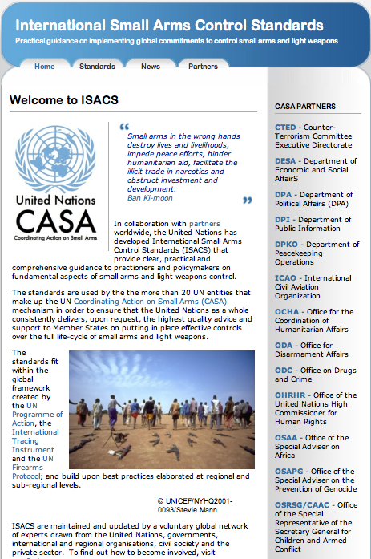
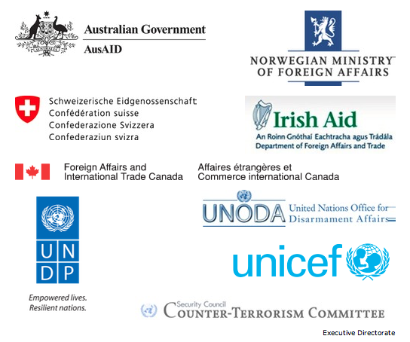
ISACS Inter-Agency Support Unit United Nations, New York www.smallarmsstandards.org patrick.mccarthy@smallarmsstandards.org support@smallarmsstandards.org @SALWstandards
With financial support from
Notes:
The UN has made ISACS modules and the ISACS Assessment Tool freely available on ourwebsite – www.smallarmsstandards.org – and has established a small Inter-Agency Support Unit to promote and support their use.
The development, application and maintenance of ISACS are made possible by financial support provided by the governments of Australia, Canada, Ireland, Norway and Switzerland; and by CASA partners CTED, UNDP, UNICEF and UNODA.

